Slide 1
Building Research Dream Teams
How to build team science and how to collaborate with not so obvious others

Slide 2
Outline of the workshop
Introduction (15 min)
Breakout: Build your dream team (45 min)
Break (10 min)
Reporting back (15 min)
Panel discussion (20 min)
Closing remarks (5 min)

Slide 3
Dream team behind this workshop
Photo
Photo
Photo
Photo
Name Organization
Name Organization
Name Organization
Name Organization
Photo
Photo
Photo
Photo
Name Organization
Name Organization
Name Organization
Name Organization

Slide 4
What is team science?
1

Slide 5
Team science is the collaborative effort to address a scientific challenge that leverages the strengths and expertise of professionals trained in different fields.
Notes:
Definition of team science from Virginia Tech University Libraries

Slide 6
The keyword is collaboration
Between researchers from different disciplines
Between researchers, industry and other societal partners
Between academic and professional support staff

Slide 7

More than 1000 people in 17 countries involved in developing the James Space Webb Telescope.
Notes:
“Cosmic Cliffs” in the Carina Nebula - JWST image, https://webbtelescope.org/contents/media/images/2022/031/01G77PKB8NKR7S8Z6HBXMYATGJ
Source for the numbers: https://www.nasa.gov/mission_pages/webb/team/index.html

Slide 8
Time to rethink the divide between academic and support staff
2

Slide 9
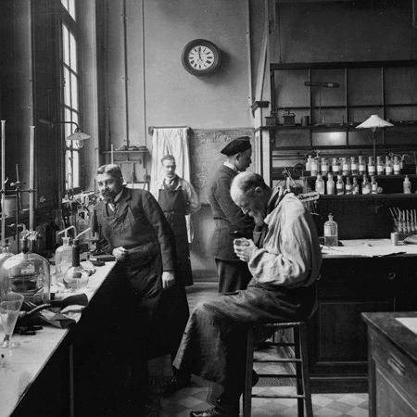
The sharp distinction between ‘academics’ and ‘support staff’ is a barrier to effective research because it discourages a culture of collaboration and appreciation of a diversity of roles and contributions.
https://doi.org/10.1038/d41586-022-01081-8
Notes:
The diversity of roles and contributions drives progress and success in research and innovation.

Slide 10
Main goals of this workshop
Get researchers and professional support staff together in one room collaboratively thinking about the skills and roles needed for effectively tackling complex research questions.
Start the discussion and raise awareness of the many skills, experiences and roles (some of which may be behind-the-scenes) that contribute to the success of the research system.

Slide 11
Online quiz
Please go to www.menti.com
Enter code
Xxxx xxxx
Let’s get to know you a little better!
Insert a QR code

Slide 12
Outline of the workshop
Introduction (15 min)
Breakout: Build your dream team (45 min)
Break (10 min)
Reporting back (15 min)
Panel discussion (20 min)
Closing remarks (5 min)

Slide 13

Breakout: build your dream team
You will be guided to discuss 4 questions
10 min per question
Write down as much as possible

Slide 14
EU project Magic Mirror
The Magic Mirror (M&M) project aims to develop a personalised health mirror. You look in a mirror every day, the mirror monitors your health based on your look and not only gives you health tips (sleep more, drink more water), but also tells you which diseases you have and reports to your GP.
You are partnering with other institutions and commercial partners to develop, test and bring this product to the market.
Project consortium:
3 universities (lead design, develop and test the product)
1 industrial partner (co-design/develop, sell the product)
1 health insurer (co-design, sell the product)
1 NGO (test, sell/use the product)
1 Patient group (co-design/development/test the product)
Citizens (co-design/test the product)

Slide 15

Breakout: build your dream team
EU project (fictional):
Title: Magic Mirror (M&M)
Description:
Health monitoring & diagnosis
Personalised health tips
Report to GP
Market product

Slide 16
Breakout: build your dream team
Project consortium setup:
3 universities
1 industrial partner
1 health insurer
1 NGO
1 patient group
Citizens
Notes:
One large, complex (in all dimensions), fictional project for people to work on… For example: a big European project to develop a personalised health mirror . You look in a mirror every day, the mirror monitors your health based on your look and not only gives you health tips (sleep more, drink more water), but also tells you which diseases you have and report to your GP. The prototype has been developed within your university, but now you are partnering with other institutions and commercial partners to bring it to market. We have 3 universities, 1 large industry partner wishing to develop and sell the product, a health insurer, an NGO, a patient group, and citizen scientists wishing to take part in the experiment.

Slide 17
Last check before the breakout
We have moderators
Each team (table) appoints a chair and a note taker
Notes:
Role of moderators:
Observe the discussions
Stimulate the quiet tables
Any questions during the discussion

Slide 18
Ideal world
Q1. What are the important aspects in this project?
Notes:
(For instance, things you need to manage, things you need to mange, societal impact, scientific impact, open science, publicity, economic gains etc., try to make them as concrete as possible)

Slide 19
Ideal world
Q2. What skills/roles are needed to address these aspects?
Notes:
Try to group the skills/roles per aspects, many-to-many connection is possible

Slide 20
Reality
Q3. Do people with those skills/roles exist?
Do you know where to find them?
Notes:
Think about own situation, e.g. for a certain skill/role identified, do people know if it exists in their institution, do people know how to approach those groups etc.

Slide 21
Reality
Q4. Can you /How do you successfully include them in the project?
Notes:
if you find the skills/roles in your institution, what are the conditions of including them in the research project

Slide 22

Coffee break
Be back in 10 min!
Credit: Pexels, CC0
Notes:
if you find the skills/roles in your institution, what are the conditions of including them in the research project

Slide 23
Outline of the workshop
Introduction (15 min)
Breakout: Build your dream team (45 min)
Break (10 min)
Reporting back (15 min)
Panel discussion (20 min)
Closing remarks (5 min)

Slide 24
Share a brief summary of your group discussions

Slide 25
Outline of the workshop
Introduction (15 min)
Breakout: Build your dream team (45 min)
Break (10 min)
Reporting back (15 min)
Panel discussion (20 min)
Closing remarks (5 min)

Slide 26
Panel discussion
What can YOU do to today/yourself to address the challenge?
Practical tips? Creative ideas?

Slide 27
Panel discussion
What can your organization do today?

Slide 28
Online quiz
Please go to www.menti.com
Enter code
Xxxx xxxx
Insert a QR code

Slide 29
Outline of the workshop
Introduction (15 min)
Breakout: Build your dream team (45 min)
Break (10 min)
Reporting back (15 min)
Panel discussion (20 min)
Closing remarks (5 min)

Slide 30
Thank you!

